Slide 1
Statistical Case Studies

Slide 2
Case Study 1: Summary of a long list of numbers (Dot plot and five number summary)

Slide 3
A survey conducted in a university contained the following question:
“What’s the fastest you have ever driven a car? ____mph.”
The data provided by the 87 males and 102 females who responded are listed in the next slide.

Slide 4
Males
110 | 110 | 109 | 90 | 140 | 105 | 150 | 110
105 | 85 | 95 | 100 | 115 | 124 | 95 | 102
85 | 120 | 110 | 120 | 115 | 94 | 125 | 90
110 | 95 | 95 | 110 | 105 | 80 | 100 | 100
120 | 100 | 100 | 80 | 100 | 120 | 105 | 80
112 | 120 | 110 | 115 | 125 | 55 | 90 | 140
120 | 110 | 110 | 90 | 115 | 95 | 145 | 125
100 | 125 | 140 | 85 | 120 | 115 | 105 | 110
80 | 85 | 140 | 120 | 92 | 130 | 125 | 105
110 | 130 | 105 | 105 | 120 | 90 | 100 | 101
60 | 125 | 120 | 100 | 115 | 95 | 110
Females
80 | 75 | 83 | 80 | 100 | 100 | 90 | 75
120 | 75 | 85 | 80 | 70 | 85 | 110 | 85
90 | 110 | 80 | 80 | 110 | 110 | 95 | 75
100 | 90 | 110 | 85 | 90 | 80 | 80 | 85
80 | 80 | 50 | 88 | 90 | 90 | 85 | 70
95 | 110 | 80 | 95 | 90 | 80 | 90 | 75
80 | 90 | 95 | 102 | 90 | 30 | 85 | 85
95 | 85 | 90 | 85 | 90 | 90 | 120 | 85
75 | 105 | 95 | 75 | 70 | 90 | 70 | 82
130 | 95 | 110 | 110 | 80 | 90 | 105 | 90
50 | 80 | 100 | 80 | 80 | 80 | 95 | 100
87 | 85 | 90 | 85 | 75 | 90 | 100 | 100
85 | 110 | 90 | 75 | 100
Notes:
Which category tends to have driven faster and by how much?

Slide 5
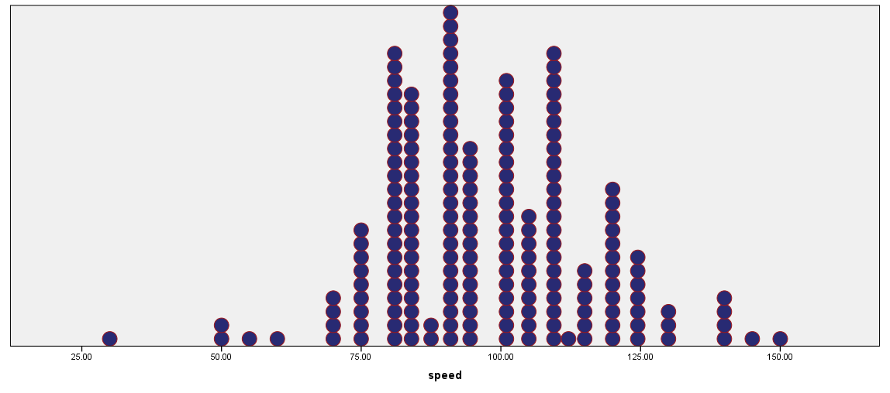

Slide 6
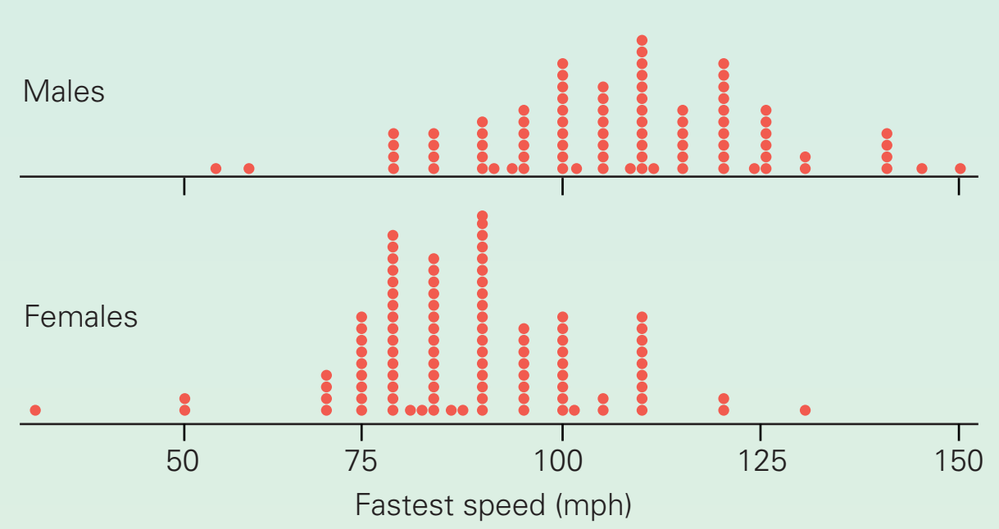
Dot Plot

Slide 7
Thought questions
Do men and women drive at the same “fastest speeds” on average?
The fastest speed driven by anyone in the class.
The slowest speed driven by a male.
The proportion of females who had driven 89 mph on average.

Slide 8
Males |  | Females
Mean | 107.4023 | Mean | 88.67816
Median | 110 | Median | 90
Mode | 110 | Mode | 90
Standard Deviation | 17.4339 | Standard Deviation | 15.04991
Sample Variance | 303.9409 | Sample Variance | 226.4999
Kurtosis | 0.647783 | Kurtosis | 2.718733
Skewness | -0.16495 | Skewness | -0.4367
Range | 95 | Range | 100
Minimum | 55 | Minimum | 30
Maximum | 150 | Maximum | 130
Count | 87 | Count | 87

Slide 9
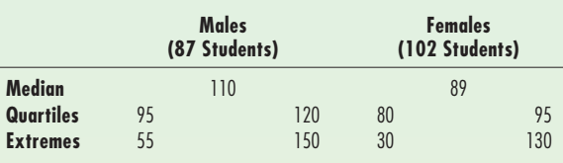
Calculate five number summary.

Slide 10
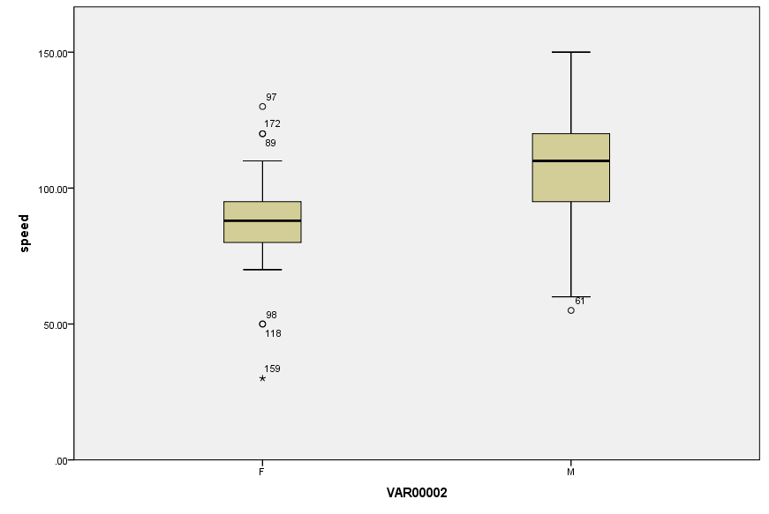

Slide 11
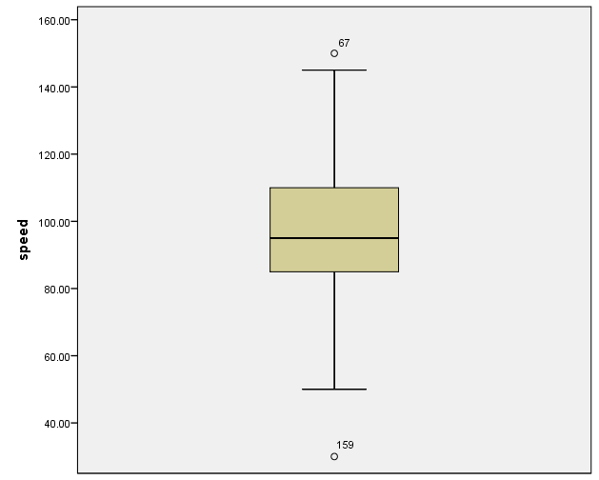

Slide 12
Case study 2 The Effect of Aspirin on Heart Attacks

Slide 13
The purpose of the experiment was to determine whether taking aspirin reduces the risk of a heart attack.
A five-year randomized experiment conducted using 22,071 male physicians between the ages of 40 and 84.
The physicians had been randomly assigned to one of the two treatment groups.
Group-I: took an ordinary aspirin tablet, Group-II: took a placebo
None of the physicians knew whether he was taking the actual aspirin or the placebo.
Notes:
A randomized experiment is a study in which treatments are randomly assigned to participants.
A treatment is a specific regimen or procedure assigned to participants by the experimenter.
A random assignment is one in which each participant has a specified probability of being assigned to each treatment.

Slide 14
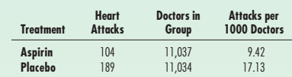
Results
Notes:
A placebo is a pill or treatment designed to look just like the active treatment but with no active ingredients. (104/11037)*1000=9.42

Slide 15
Thought questions
To what population does the conclusion of this study apply?
What about other important risk factors such as age, amount of exercise, and dietary habits?
Are the results statistically significant?
How many categorical variables are there?:
Dependent/Response Variable:
Independent/Explanatory variable:
What do you think is the base rate of heart attacks for men like the ones in this study?

